Slide 1
Scan Me
For More Info!
Notes:
Vorlage

Slide 2
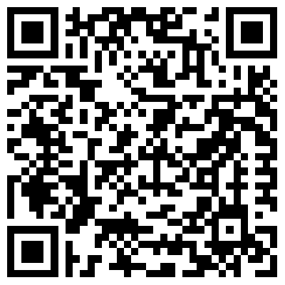
Scan Me
For More Info!
Notes:
Treppe

Slide 3
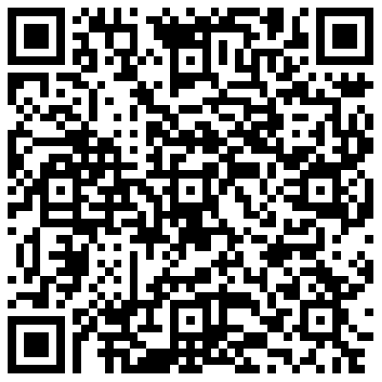
Scan Me
For More Info!
Notes:
Kochen

Slide 4
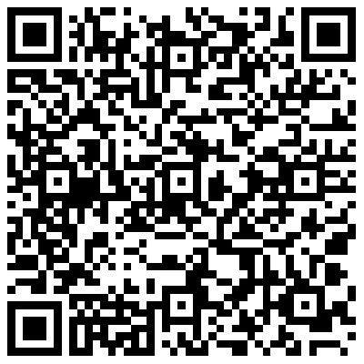
Scan Me
For More Info!
Notes:
Fahrrad

